Slide 1
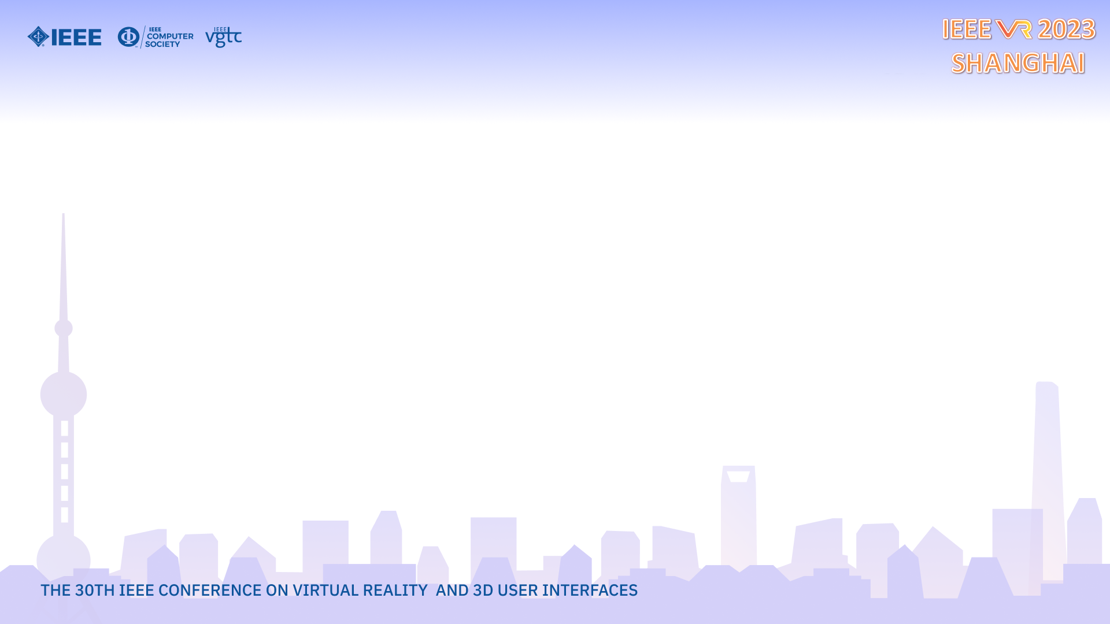

Scaling VR Video Conferencing
Mallesham Dasari, Edward Lu, Michael W. Farb, Nuno Pereira,
Ivan Liang, Anthony Rowe
Notes:
Hello everyone, my name is Mallesh. I am a postdoctoral researcher at Carnegie Mellon University. Today, I am going to present our work on scalable VR video conferencing.

Slide 2
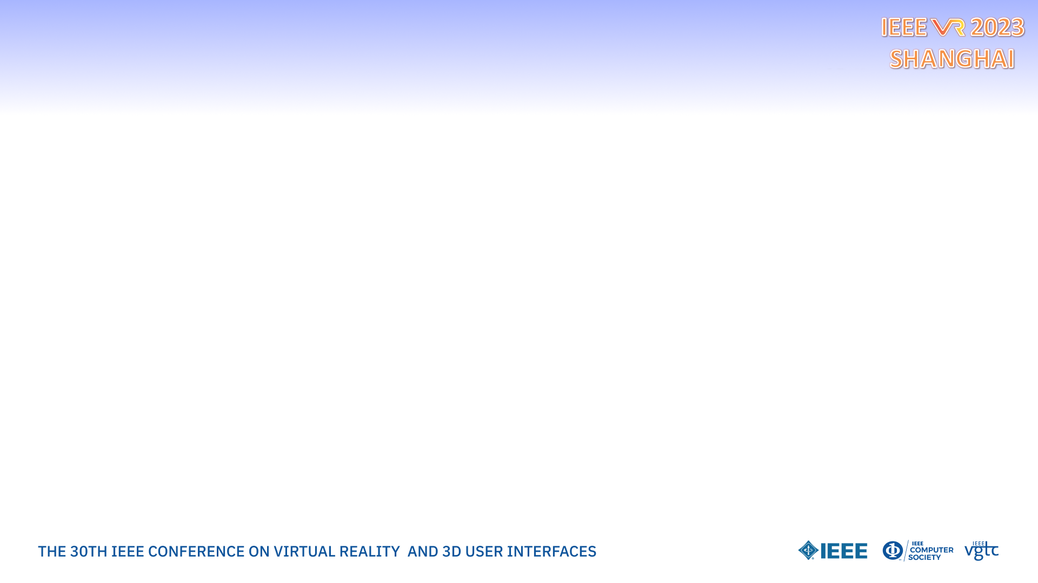




VR Video Conferencing
Immersive
Interactive
Notes:
Virtual reality based video conferencing allows immersive and interactive experiences, this is unlike traditional 2D zoom conferencing style applications. And so, There has been a tremendous interest in this space from industry and academia with several state of the art solutions that include for example second life, altspce VR, meta’s horizon worlds, and mozill hubs, all these systems comprises of a multi-billion dollar ecosystem.

Slide 3
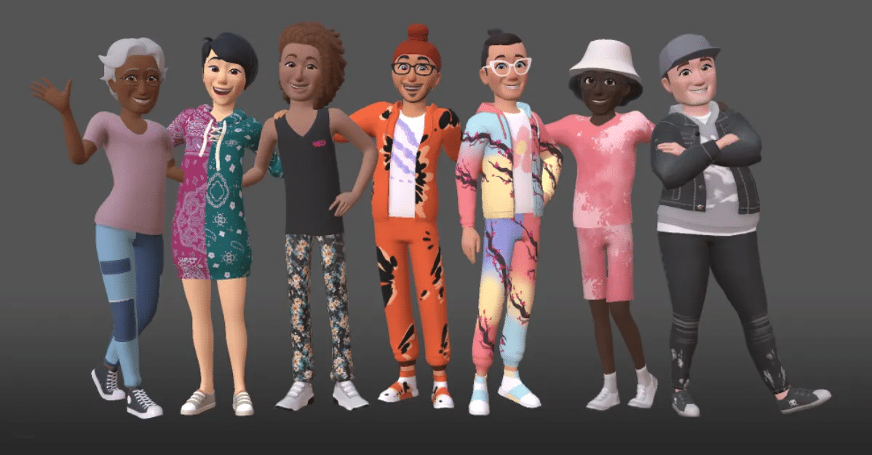
Limitations of Existing Solutions
Avatars
No interactive video
Not scalable to 100s of users
within a single room
Notes:
However, the problem with the existing solutions is that they are mainly avatar based, and do not realistic interactive video experience. More importantly these solutions falls short on scaling to 100s of users within a single room.

Slide 4

Our Solution: ARENA
2D Video textured mapped onto 3D Cube
Notes:
We introduce our solution called, ARENA to address the limitations of existing systems. ARENA supports a VR video conferencing capability by projecting a 2D texture on to 3D cube when interacting with users. This allows for more interactive experience unlike the existing avatar based VR chat or static image based 3D space exploration. We started this project during the pandemic, and used in smaller group sizes and meetings.

Slide 5
ARENA: VR Video Conferencing
Challenges
Many concurrent flows as opposed to a small subset of “pinned” users or active speakers
Size and total number of engaged users increases with the size of the virtual worlds
Highly dynamic connections
Need to scale as the users grow and shrink in size
Notes:
However, as we started using this platform at large scale, for example, hosting workshops, poster sessions, we faced several challenges in terms of scalability and encountered unique user dynamics for our VR video scenario as opposed to traditional conferencing systems. This led to a series of contributions to scale our ARENA system.

Slide 6
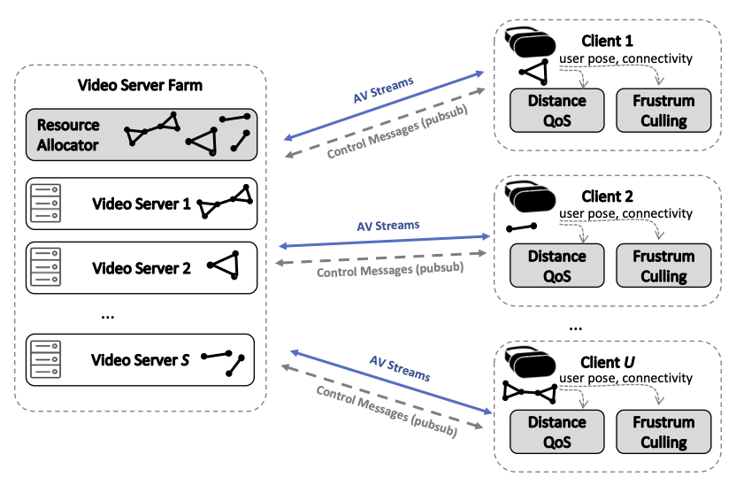
Scaling ARENA
Virtual worlds need to scale to 100s of users in a single room
Notes:
So, here is an overview of scalable ARENA that scales to 100s of users in a single room. On the server side, we introduce a resource provisioning mechanism to create clusters of users that belong to a single room that will allow us to control the flow interaction effectively. On the client side, we introduce two locality based optimizations to reduce the bandwidth requirement. One is Frustum culling and another is distance based QoS. So, let’s go into the details of each.

Slide 7
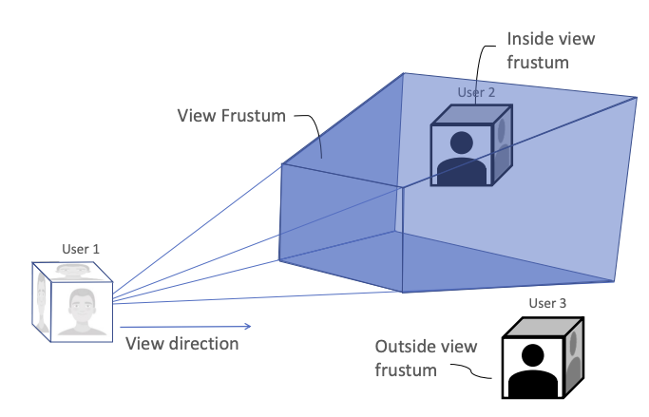
Frustum Video Culling
Stream video from users within the view frustum
Notes:
The first obvious optimization is frustum video culling, where we stream videos of users that are within view frustum and disable the audio and video flows from the rest of the other users. This optimization not only reduces bandwidth significantly but also reduces the transcoding computation on the server-side.

Slide 8
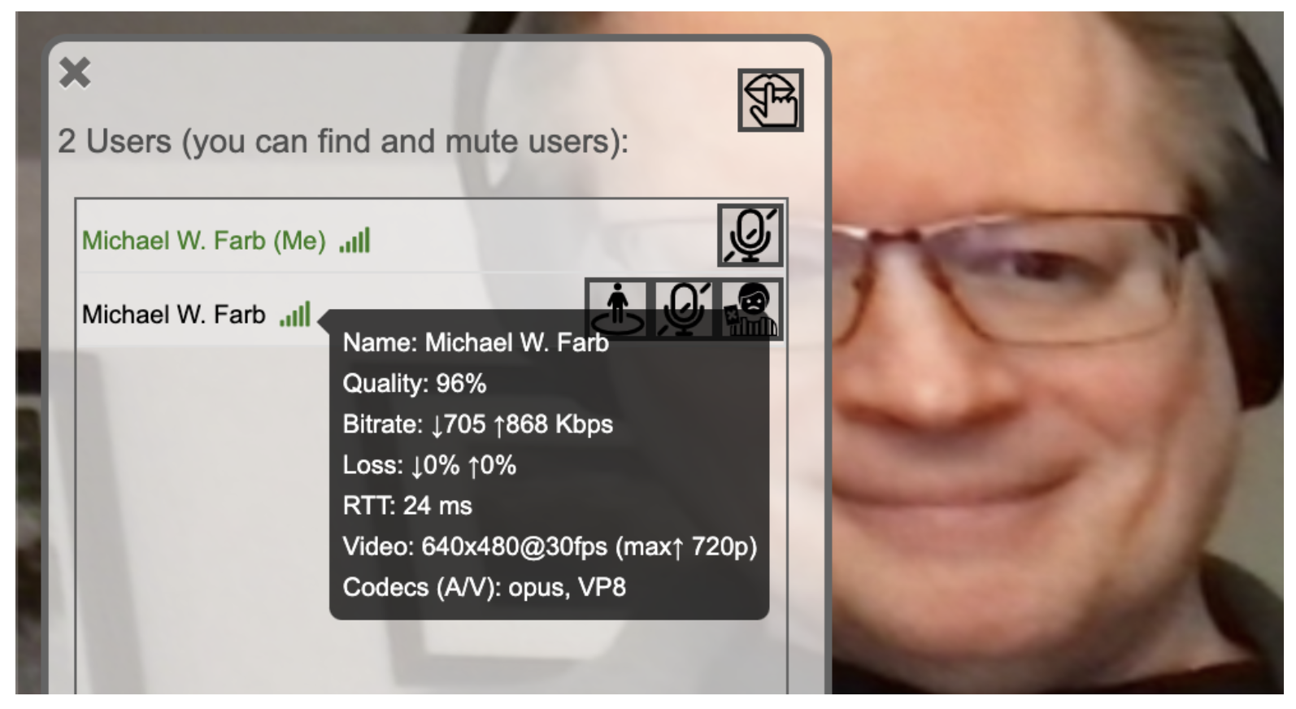
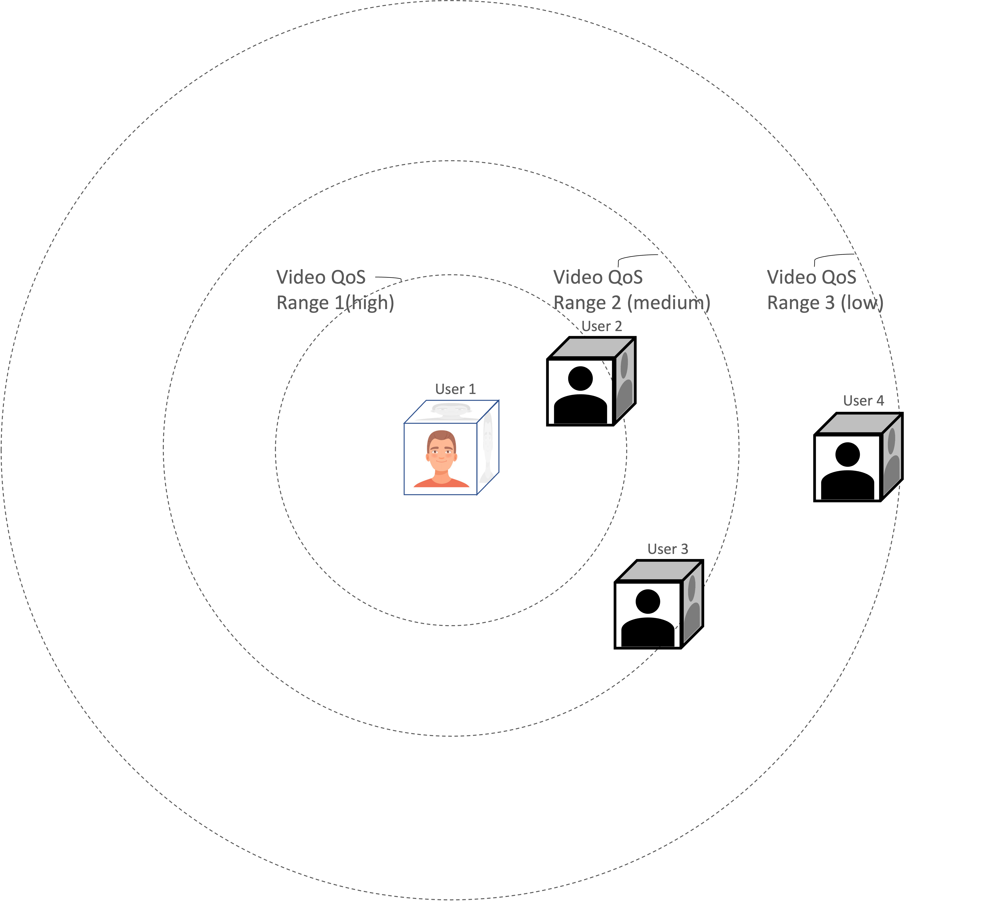
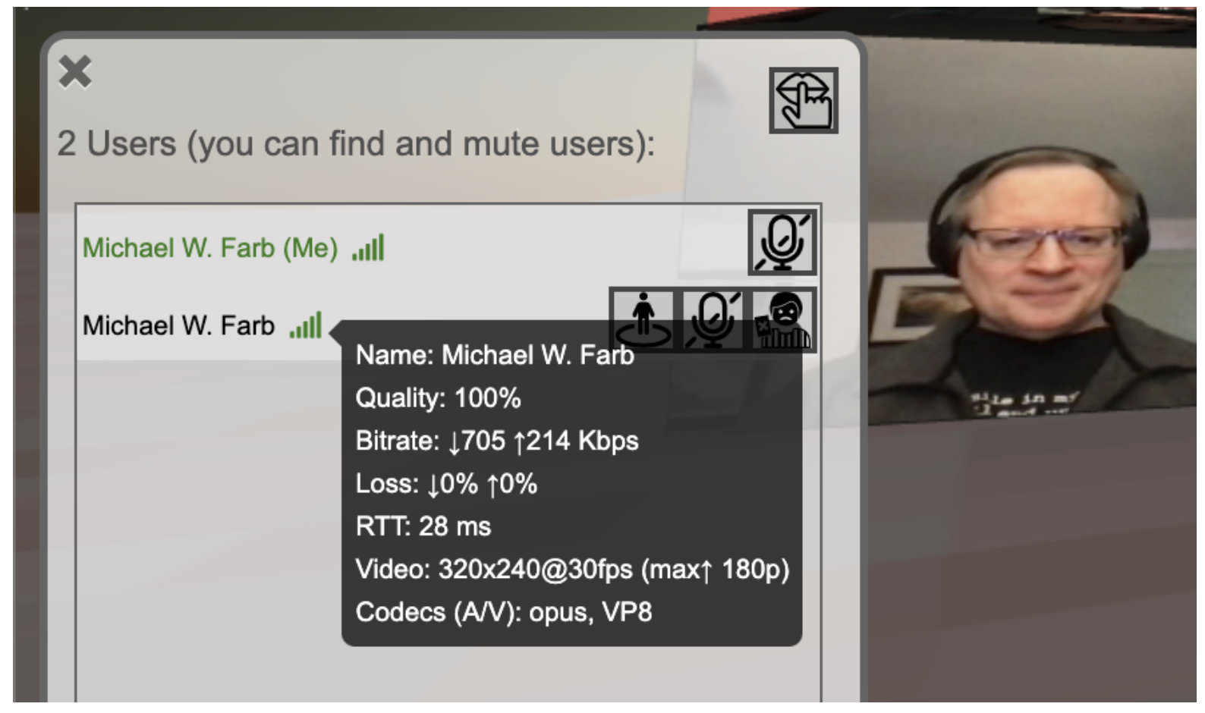
Distance based QoS
Far View – Low Quality
Near View – High Quality
Notes:
The second optimization that is unique to ARENA is distance based quality adaptation. We design an algorithm to provide a high quality video of users that are close and to progressively decrease the quality as the distance between the users increases. This is because we observed diminishing returns in terms of quality experiences as we cannot see far most users clearly. For example in left figure, for user1, the video of user 2 will be in high quality, user3 will be in medium quality, and user 4 will be in low quality. The figure on the right shows statistics bar during the call, showing high quality above because the user is close, and low quality below as user is far away.
This optimization similar to culling, reduces the bandwidth significantly and minimizes the transcoding computation on the server side.

Slide 9


Resource Allocator
Adapt to user dynamics
s₀
s₁
s₀
s₁
Bandwidth Waste
Increased Echo Potential
Notes:
The last optimization is resource allocation. The problem we solve here is that a typical video server has a limited capacity in terms of how many users it can service based on a combination of network and computational resources. Keeping this goal in mind, we design an optimal resource provisioning mechanism to efficiently cluster users based on a connectivity graph. Considering an example here on the right side, given a graph, a naïve solution to group them into two clusters is by having both users in the middle overlapping on two servers. However, the problem with this approach is that there is a bandwidth waste because both users will stream the audio and video to both clusters of users even though we do not need. Second, there is a potential for increased echo. Instead, we group the users dynamically into unique users to effectively reduce the redundant users in the overlapping areas. We formulate the allocation task as a minimum k-cut balanced graph partitioning problem. You can find more details in the paper.

Slide 10
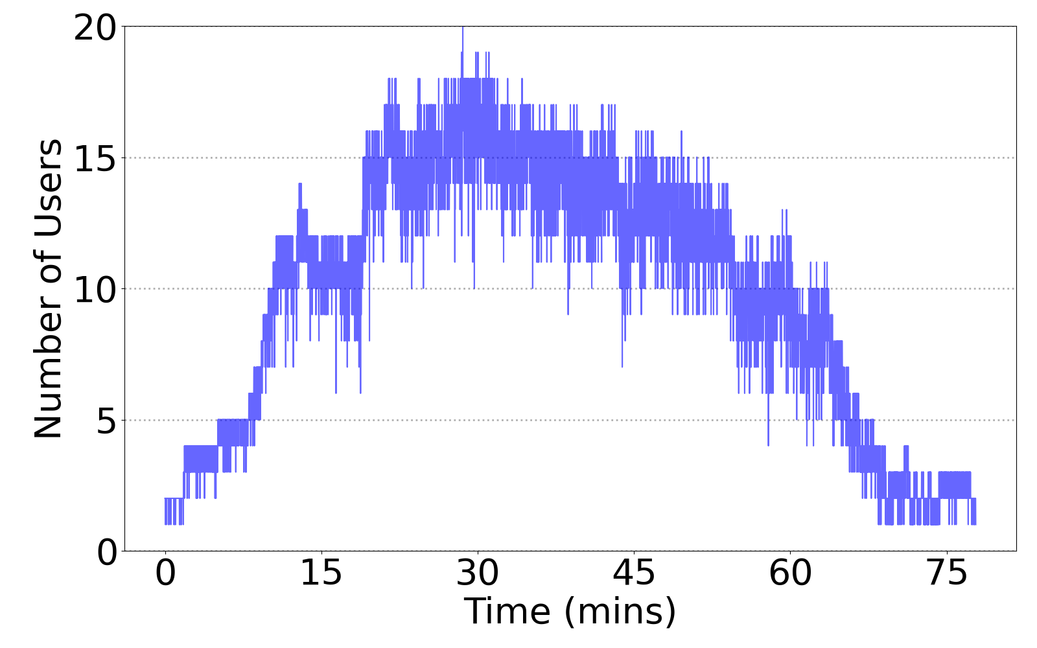
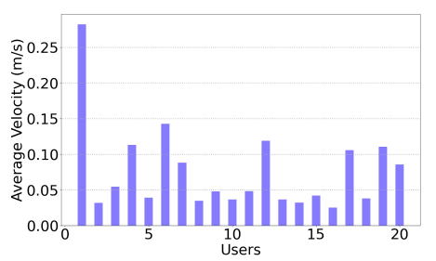
System Implementation
Operates on browsers in Desktops, Laptops, Phones, AR/VR Headsets
A Jitsi video bridge server
Web server hosting client JS, authentication, MQTT pub-sub messaging
Replay of user motion for emulation and simulation of 100s of users with Brownian motion
NSF Poster Session
User Distribution
Notes:
We have built ARENA as a 3D web based user-programmable collaborative system. It can run on browsers in desktops, laptops, phones, and many ar/vr headsets. We use the Jitsi video bride server and a web server hosting client JS for authentication, mqtt pub sub messaging for exchanging user pose. To evaluate our experiments, we use real user traces from one of our NSF poster session, and also simulate 100s of users using Brownian motion. For example, the figures on the right shows the user dynamics on our NSF poster session. There are 20 users over a duration of more than an hour with average velocity of more than 25cm/sec for each user.

Slide 11
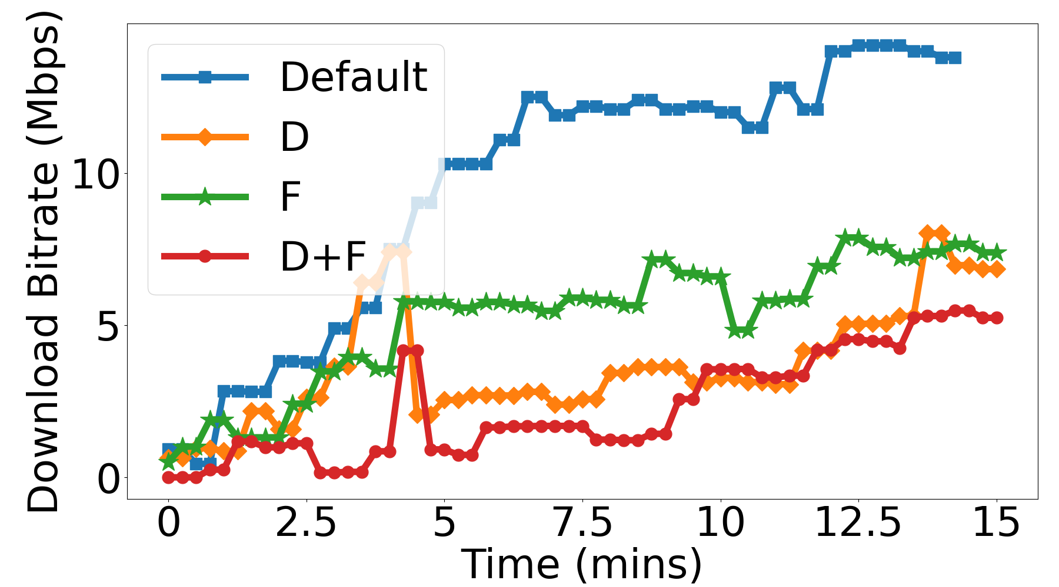
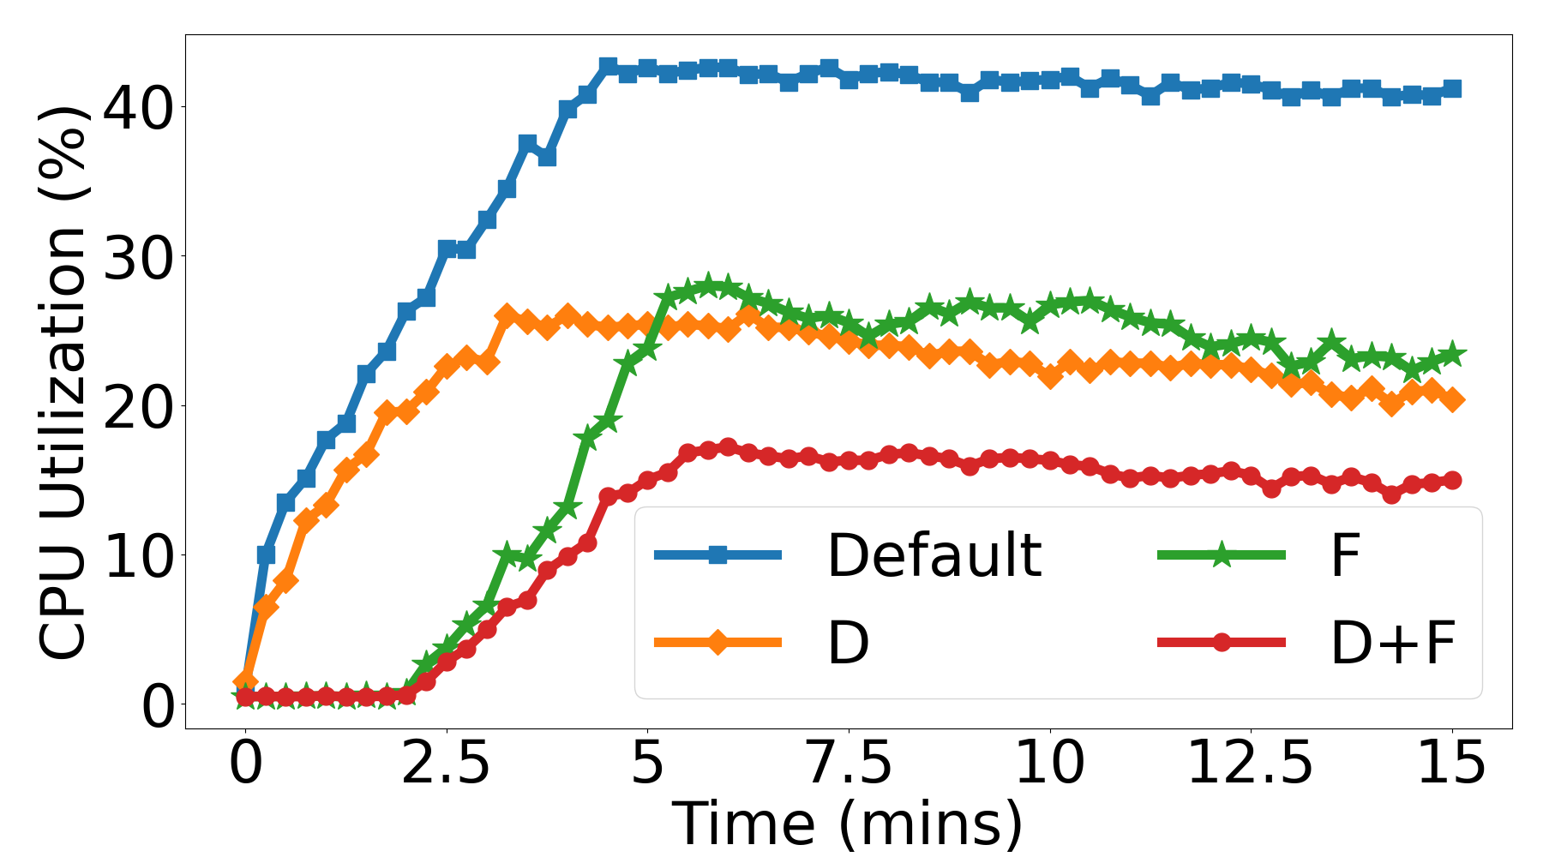
Performance Evaluation
D: Distance based QoS, F: Frustum Culling
ARENA requires 3x less bandwidth
ARENA requires 25 Percentage points less compute
Notes:
So, let’s see some of the performance results of our system. The first result is about bandwidth. The figure here shows the download bitrate with default case where there is no locality based optimizations, with individual plus combined effect of each optimization. ARENA with both optimizations shows a 3x less bandwidth requirement compared to the default system. Similarly, the figure on the right measures CPU utilization, where we observe a 25 percentage points less compute with ARENA compared to the default system.

Slide 12
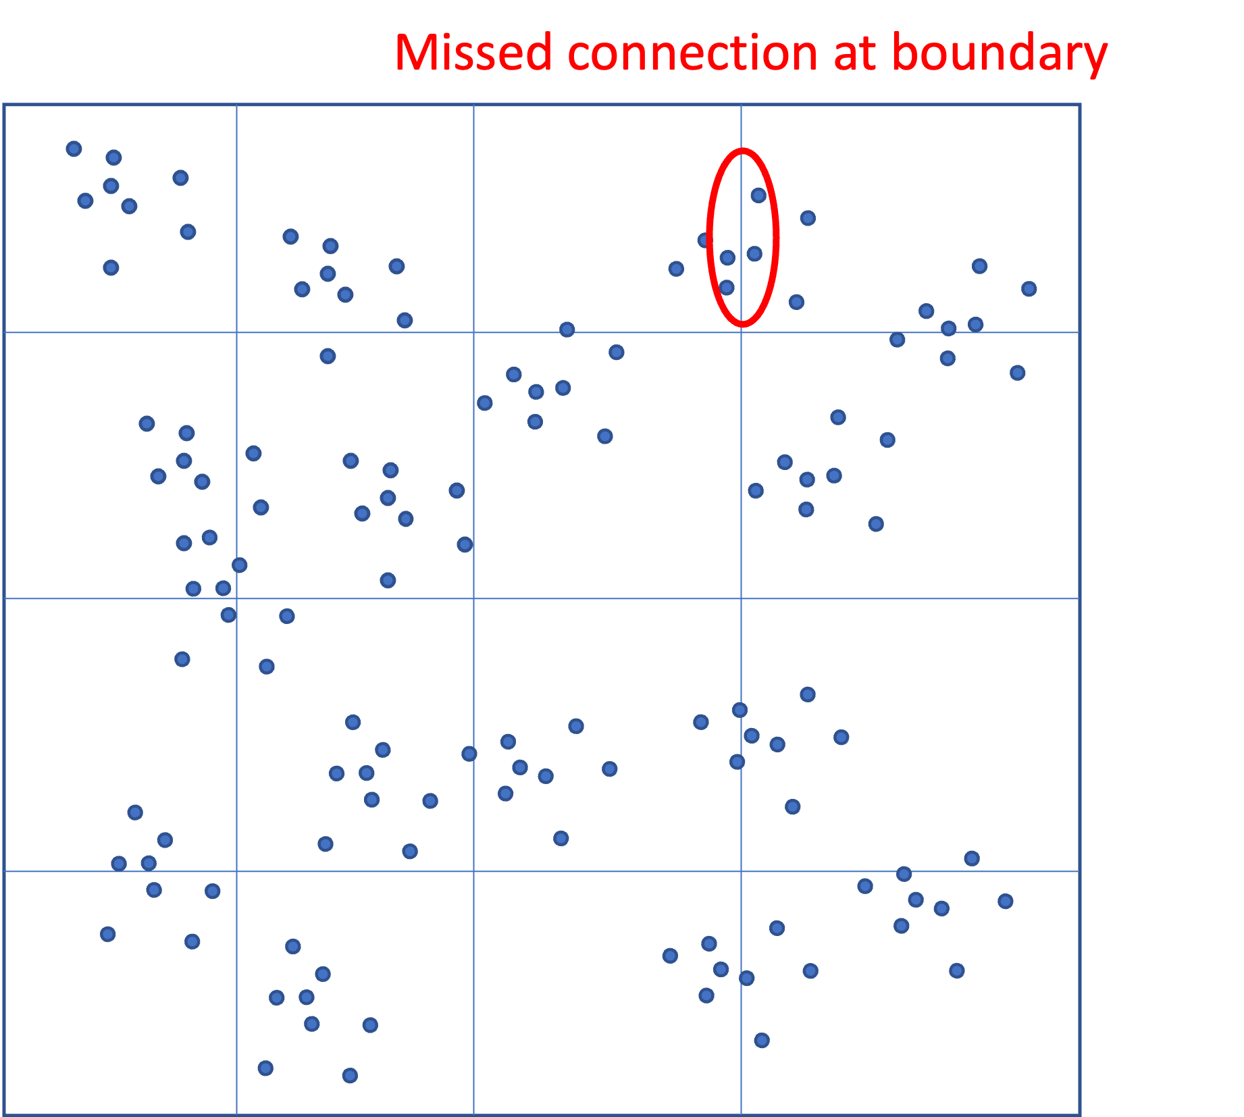
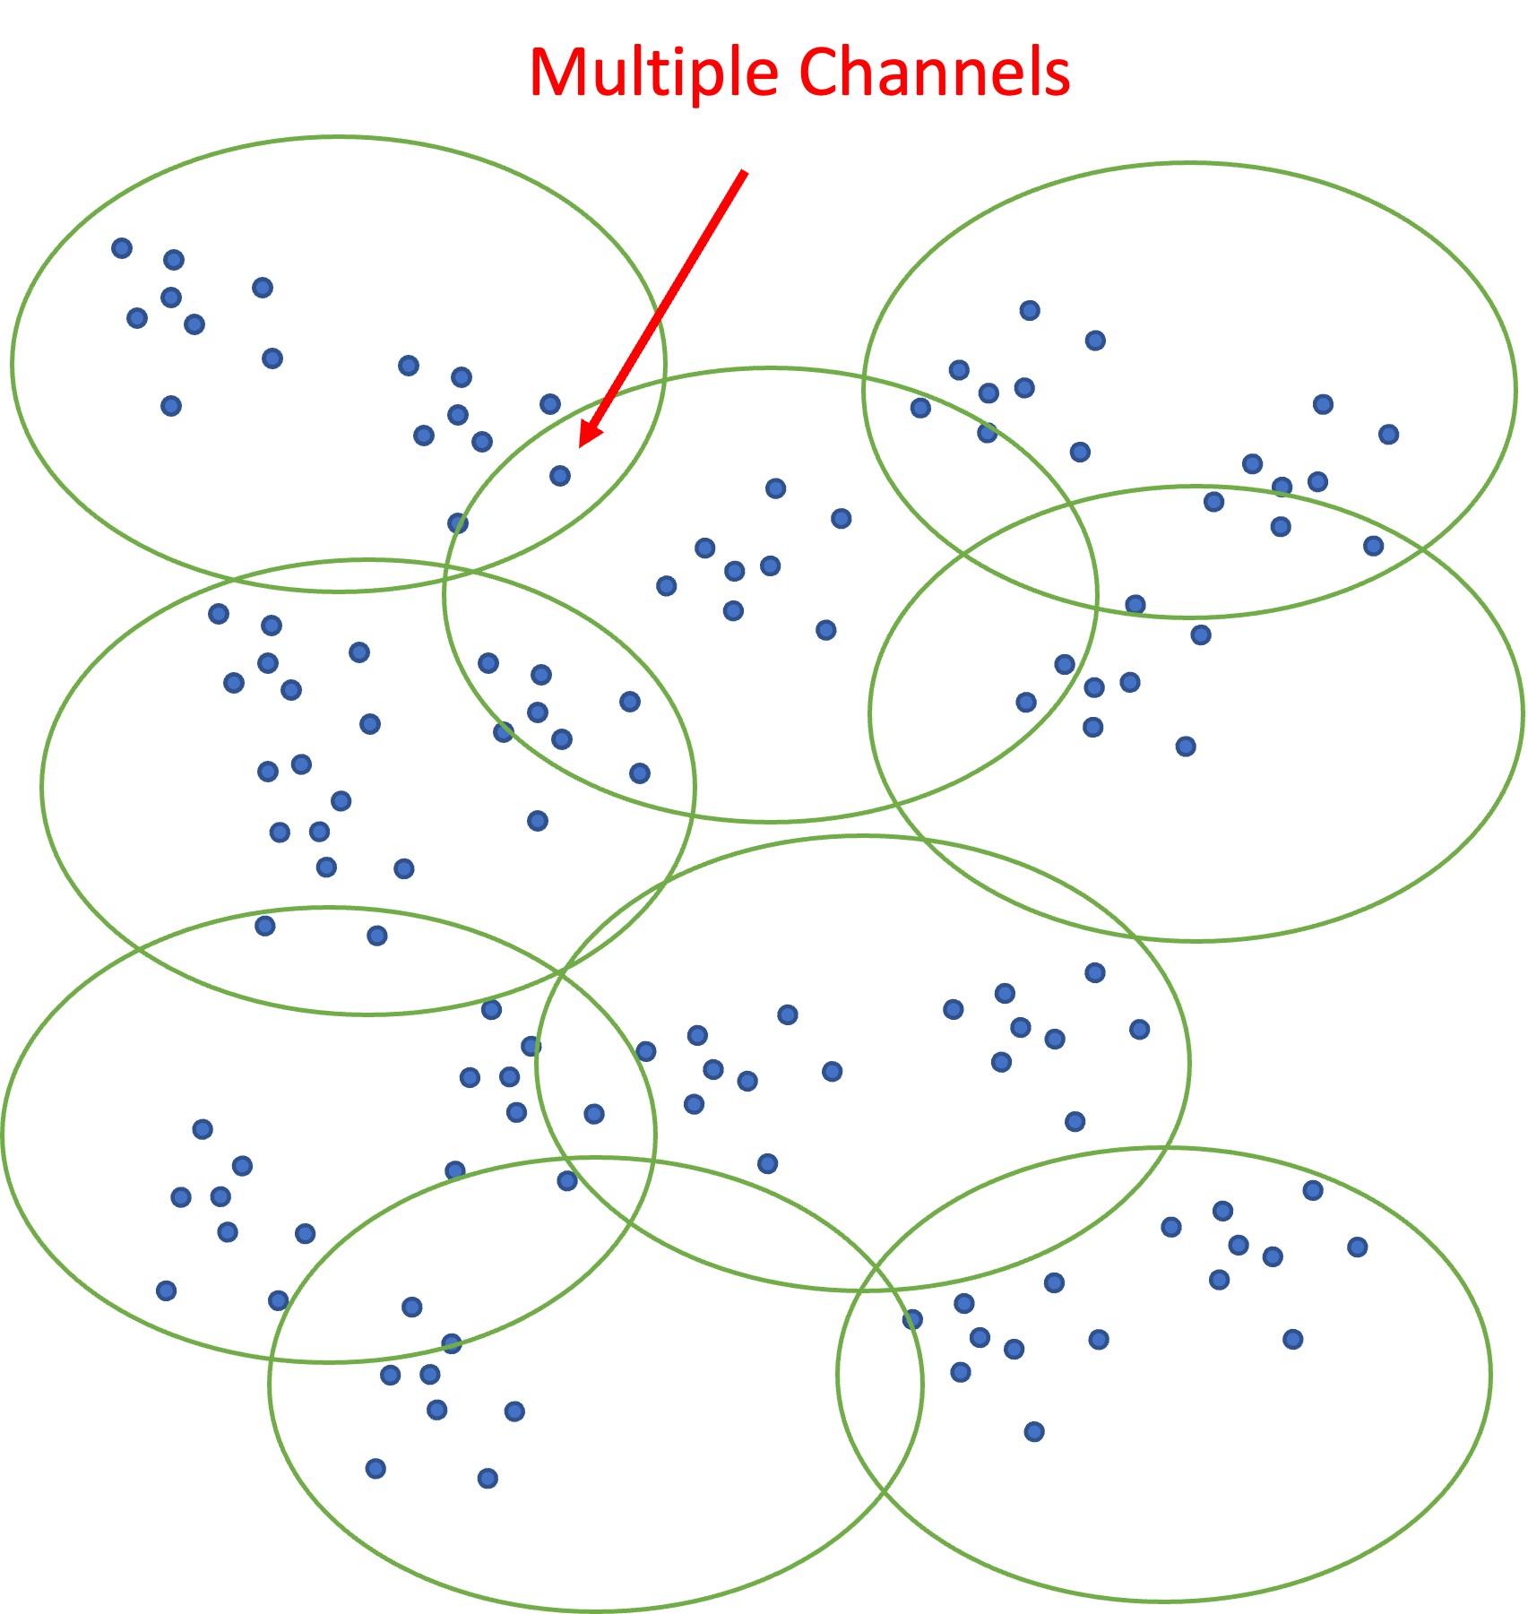
Performance Evaluation: Scalability
Uni-Grid: uniform static grid environment
Cliques: Dynamic graph partition of ARENA
Notes:
This is a final result of our system that I would like to highlight. We evaluate scalability of our system in terms of the number of supported clients with respect to multiple servers. As mentioned earlier, the server is limited to support only a few tens of clients and once it reaches its maximum load in terms of CPU and network, it has to either drop the client connections or support all connections but reduce the quality of other connections. We compare our system with a baseline system where the virtual environment is uniformly divided into static grids that doesn’t take into account of the users’ motion. The key benefit with approach is that it can support more clients effectively but often misses users connections because of the movement across neighboring grid cells. We call this as Uni-Grid. And our solution is Cliques, which are formed by using our dynamic graph partitioning technique.

Slide 13
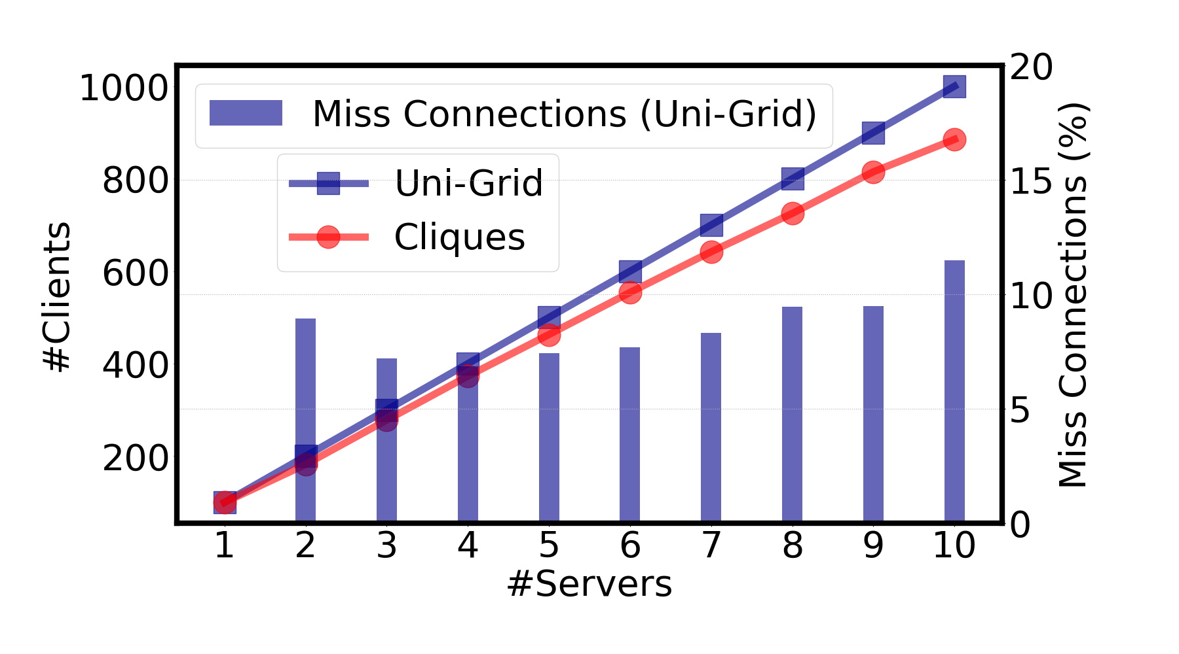
Performance Evaluation: Scalability
Uni-Grid: uniformly cluster users in a static grid environment
Cliques: Dynamic graph partition of ARENA
Unlike ARENA cliques, traditional Uni-grid approach has significant number of missed connections
Notes:
So the figure here shows the number of clients supported on the y-axis, and the number of servers needed on the x-axis. Additionally, the second y-axis shows the number of missed connections in case of Uni-Grid. As shown, ARENA is close Uni-Grid in terms of number of clients but with zero missed connections, where as Uni-Grid has a significant number of missed connections as we increase the number of users. So, that concludes the performance evaluation.

Slide 14
Conclusion
ARENA for VR Video Conferencing
Frustum Culling
Distance based QoS
Resource Allocator
Scales to 100s of users
Low bandwidth
Low CPU utilization
For more info visit: https://arenaxr.org/
Notes:
To summarize, we present our VR video conferencing platform called ARENA, with scalable optimizations such as frustrum culling, distance based quality adaptation, graph partitioning based resource allocator. We showed ARENA scales to 100s of users, with low bandwidth and low CPU utilization. You can find more details of our platform this arenaxr.org webpage, where we open sourced our system. With that I will stop here, thank you very much.

